Slide 1



Introduction to Emerging Technologies
Chapter-3
Introduction to Artificial Intelligence

Slide 2
Chapter 3:Artificial Intelligence
After completing this chapter, the students will be able to:
  Explain what artificial intelligence (AI) is.
  Describe the eras of AI.
  Explain the types and approaches of AI.
  Describe the applications of AI in health, agriculture, business and education
  List the factors that influenced the advancement of AI in recent years.
  Understand the relationship between the human’s way of thinking and AI systems
  Identify AI research focus areas.
  Identify real-world AI applications, some platforms, and tools.

Slide 3
3.1. What is Artificial Intelligence (AI)
Artificial Intelligence is composed of two words Artificial and Intelligence.
  Artificial –defines "man-made," and
  intelligence defines "thinking power", or “the ability to learn and solve problems”
    Hence Artificial Intelligence means "a man-made thinking power."

Slide 4
What is AI.....
Artificial Intelligence (AI) can be defined as the branch of computer science by which we can create intelligent machines which can behave like a human, think like humans, and able to make decisions.
Intelligence, as we know, is the ability to acquire and apply knowledge.
  Knowledge is the information acquired through experience.
  Experience is the knowledge gained through exposure (training).

Slide 5
What is AI…
Artificial Intelligence exists when a machine can have human-based skills such as learning, reasoning, and solving problems. With Artificial Intelligence you do not need to preprogram a machine to do some work, despite that you can create a machine with programmed algorithms which can work with own intelligence. Intelligence is composed of:
  ➢ Reasoning
  ➢ Learning
  Perception
  ➢ Linguistic Intelligence
  ➢ Problem Solving

Slide 6
What is AI….
An AI system is composed of an agent and its environment.
An agent (e.g., human or robot) is anything that can perceive its environment through sensors and acts upon that environment through effectors.
Intelligent agents must be able to set goals and achieve them.

Slide 7
What is AI…..
High-profile examples of AI include
autonomous vehicles,
medical diagnosis, creating art (such as poetry),
proving mathematical theorems,
prediction of judicial decisions and targeting online advertisements
image recognition in photographs,
  spam filtering,
  online assistants (such as Siri),
  playing games (such as Chess),
  search engines

Slide 8
What is AI…..
The advent of Big Data, driven by the arrival of the internet, smart mobile and social media has enabled AI algorithms, in particular from Machine Learning and Deep Learning, to leverage Big Data and perform their tasks more optimally.
Machine Learning is an advanced form of AI where the machine can learn as it goes rather than having every action programmed by humans.
Machine learning, a fundamental concept of AI research since the field’s inception, is the study of computer algorithms that improve automatically through experience.

Slide 9
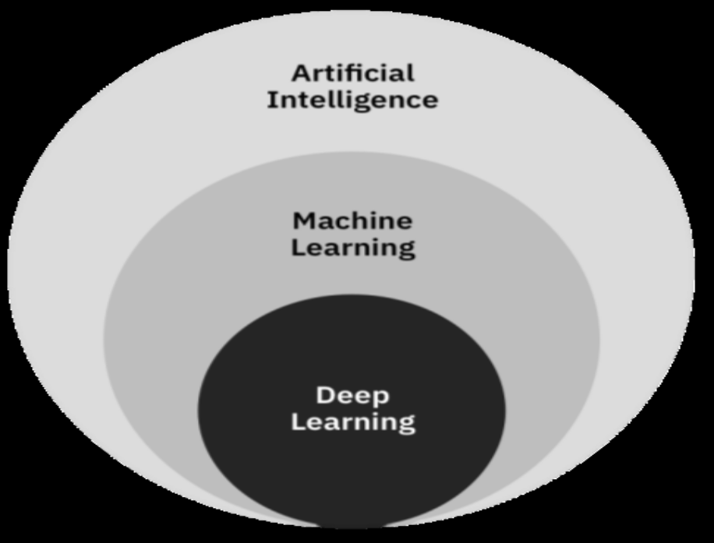
What is AI…..
Neural networks are biologically inspired networks that extract features from the data in a hierarchical fashion.
The field of neural networks with several hidden layers is called deep learning.
Figure 3.1 Artificial Intelligence (AI), Machine Learning (ML) and Deep Learning (DL)

Slide 10
3.1.1 Need for Artificial Intelligence
To create expert systems that exhibit intelligent behavior with the capability to learn, demonstrate, explain and advice its users.
Helping machines find solutions to complex problems like humans do and applying them as algorithms in a computer-friendly manner.

Slide 11
3.1.2 Goals of Artificial Intelligence
Following are the main goals of Artificial Intelligence:
  1. Replicate human intelligence
  2. Solve Knowledge-intensive tasks
  3. An intelligent connection of perception and action
  4. Building a machine which can perform tasks that requires human intelligence.
  5. Creating some system which can exhibit intelligent behavior, learn new things by itself, demonstrate, explain, and can advise to its user.

Slide 12
3.1.3 What Comprises to Artificial Intelligence?
To create the AI-first we should know that how intelligence is composed, so Intelligence is an intangible part of our brain which is a combination of:
  Reasoning,
  Learning,
  Problem-solving,
  Perception ,
  Language understanding, etc.

Slide 13
What comprises AI…..
To achieve the above factors for a machine or software ,Artificial Intelligence requires the following disciplines:
  ✓ Mathematics ✓ Sociology ✓ Statistics
  ✓ Biology ✓ Neurons Study
  ✓ Psychology ✓ Computer Science

Slide 14
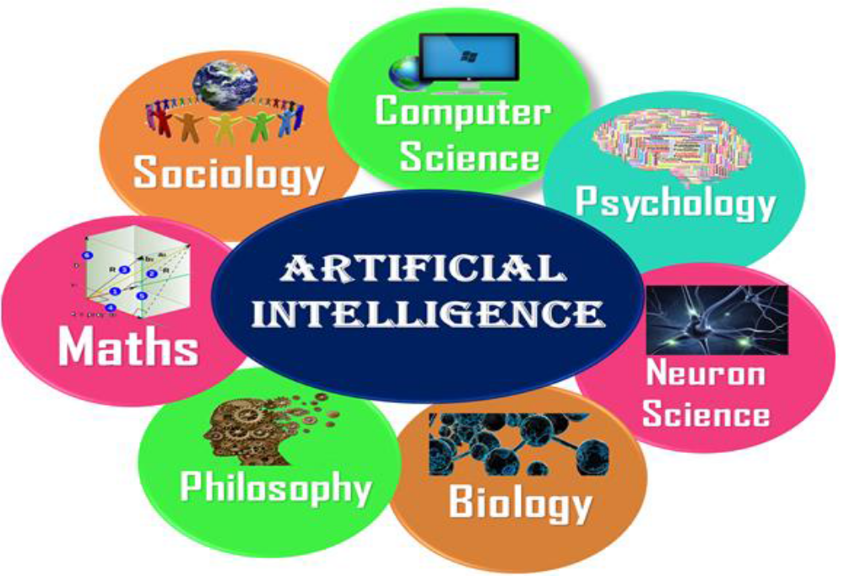
What comprises AI…..
Figure 3.2 Artificial Intelligence is multidisciplinary

Slide 15
3.1.4.Advantages of Artificial Intelligence
Following are some main advantages of Artificial Intelligence:
➢ High Accuracy with fewer errors: AI machines or systems are prone to fewer errors and high accuracy as it takes decisions as per pre-experience or information.
➢ High-Speed: AI systems can be of very high-speed and fast-decision making, because of that AI systems can beat a chess champion in the Chess game.
➢ High reliability: AI machines are highly reliable and can perform the same action multiple times with high accuracy.

Slide 16
Advantages of AI….
➢ Useful for risky areas: AI machines can be helpful in situations such as defusing a bomb, exploring the ocean floor, where to employ a human can be risky.
➢ Digital Assistant: AI can be very useful to provide digital assistant to users such as AI technology is currently used by various E-commerce websites to show the products as per customer requirements.
➢ Useful as a public utility: AI can be very useful for public utilities such as a self-driving car which can make our journey safer and hassle-free, facial recognition for security purposes, Natural language processing

Slide 17
3.1.5 Disadvantages of Artificial Intelligence
Following are the disadvantages of AI:
High Cost: The hardware and software requirement of AI is very costly as it requires lots of maintenance to meet current world requirements.
➢ Can't think out of the box: AI machines cannot work out of the box, as the robot will only do that work for which they are trained, or programmed.
No feelings and emotions: AI machines do not have the feeling so they cannot make any kind of emotional attachment with humans.

Slide 18
Disadvantages of AI…..
Increase dependence on machines: With the increment of technology, people are getting more dependent on devices and hence they are losing their mental capabilities.
➢ No Original Creativity: AI machines cannot beat this power of human intelligence and cannot be creative and imaginative.

Slide 19
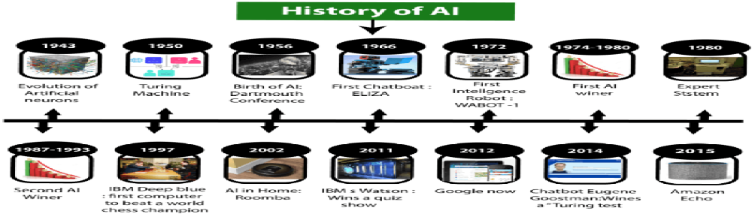
3.2. History of AI
The following are some milestones in the history of AI which define the journey from the AI generation to till date development.
Figure 3.3 History of Artificial Intelligence (AI)

Slide 20
History of AI….
A. Maturation of Artificial Intelligence (1943-1952)
➢ The year 1943: The first work which is now recognized as AI was done by Warren McCulloch and Walter pits in 1943. They proposed a model of artificial neurons.
➢ The year 1949: Donald Hebb demonstrated an updating rule for modifying the connection strength between neurons. His rule is now called Hebbian learning.
The year 1950: The Alan Turing who was an English mathematician and pioneered Machine learning in 1950. Alan Turing publishes "Computing Machinery and Intelligence" in which he proposed a test.

Slide 21
History of AI….
B. The birth of Artificial Intelligence (1952-1956)
The year 1955: An Allen Newell and Herbert A. Simon created the "first artificial intelligence program" Which was named "Logic Theorist".
The year 1956: The word "Artificial Intelligence" first adopted by American Computer scientist John McCarthy at the Dartmouth Conference. For the first time, AI coined as an academic field.

Slide 22
History of AI….
C. The golden years-Early enthusiasm (1956-1974)
The year 1966: The researchers emphasized developing algorithms that can solve mathematical problems. Joseph Weizenbaum created the first chatbot in 1966, which was named as ELIZA.
The year 1972: The first intelligent humanoid robot was built in Japan which was named WABOT-1.

Slide 23
History of AI….
D. The first AI winter (1974-1980)
was the first AI winter duration. AI winter refers to the time period where computer scientists dealt with a severe shortage of funding from the government for AI researches.
E. A boom of AI (1980-1987)
The year 1980: AI came back with "Expert System". Expert systems were programmed that emulate the decision-making ability of a human expert.

Slide 24
History of AI….
F. The second AI winter (1987-1993)
Again, Investors and government stopped in funding for AI research due to high cost but not efficient results. The expert system such as XCON was very cost-effective.
G. The emergence of intelligent agents (1993-2011)
The year 1997: In the year 1997, IBM Deep Blue beats world chess champion, Gary Kasparov, and became the first computer to beat a world chess champion.

Slide 25
History of AI….
The year 2002: for the first time, AI entered the home in the form of Roomba, a vacuum cleaner.
The year 2006: AI came into the Business world until the year 2006. Companies like Facebook, Twitter, and Netflix also started using AI.
H. Deep learning, big data and artificial general intelligence (2011-present)
The year 2011: In the year 2011, IBM's Watson won jeopardy, a quiz show, where it had to solve complex questions as well as riddles.

Slide 26
History of AI….
The year 2012: Google has launched an Android app feature "Google now", which was able to provide information to the user as a prediction.
The year 2014: In the year 2014, Chatbot "Eugene Goostman" won a competition in the infamous "Turing test."
The year 2018: The "Project Debater" from IBM debated on complex topics with two master debaters and also performed extremely well.

Slide 27
3.3. Levels of AI
Stage 1 – Rule-Based Systems
The most common uses of AI today fit in this bracket, covering everything from business software (Robotic Process Automation) and domestic appliances to aircraft autopilots.
Stage 2 – Context Awareness and Retention
Algorithms that develop information about the specific domain they are being applied in. They are trained on the knowledge and experience of the best humans, and their knowledge base can be updated as new situations and queries arise.

Slide 28
Levels of AI…
Stage 3 – Domain-Specific Expertise
Going beyond the capability of humans, these systems build up expertise in a specific context taking in massive volumes of information which they can use for decision making.
Stage 4 – Reasoning Machines
These algorithms have some ability to attribute mental states to themselves and others – they have a sense of beliefs, intentions, knowledge, and how their own logic works. This means they could reason or negotiate with humans and other machines.

Slide 29
Levels of AI…
Stage 5 – Self Aware Systems / Artificial General Intelligence (AGI)
These systems have human-like intelligence – the most commonly portrayed AI in media – however, no such use is in evidence today.
Stage 6 – Artificial Super intelligence (ASI)
Logically it is difficult for humans to articulate what the capabilities might be, yet we would hope examples would include solving problems we have failed to so far, such as world hunger and dangerous environmental change.

Slide 30
Levels of AI…
Stage 7 – Singularity and Transcendence
This is the idea that development provided by ASI (Stage 6) leads to a massive expansion in human capability.
Human augmentation could connect our brains to each other and to a future successor of the current internet.

Slide 31
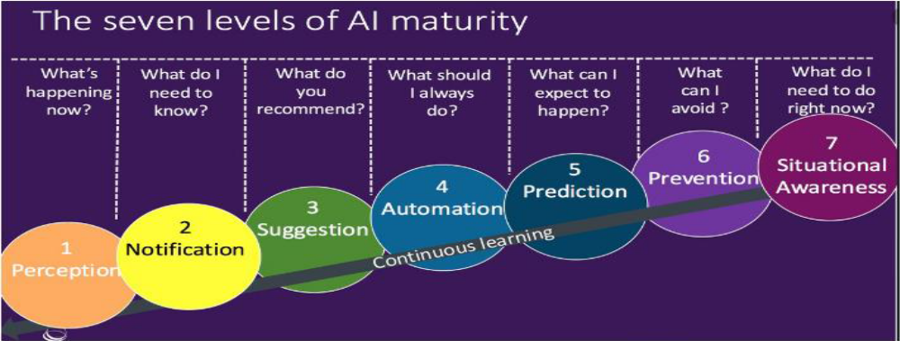
Levels of AI….
Figure 3.4 The seven layers of AI maturity

Slide 32
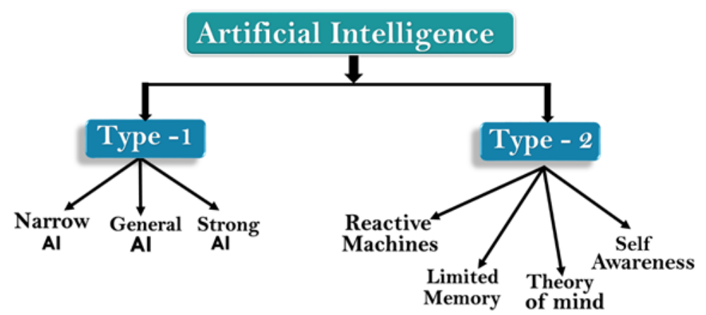
3.4. Types of AI
Artificial Intelligence can be divided into various types, there are mainly two types of the main categorization which are based on capabilities and based on functionally of AI. Following is the flow diagram which explains the types of AI.
Figure 3.5 types of Artificial Intelligence (AI)

Slide 33
Types of AI…..
A. Based on Capabilities
Weak AI or Narrow AI:
  Is able to perform a dedicated task with intelligence.
  Is the most common and currently available AI in world of AI
  cannot perform beyond its field or limitations and it is also termed as weak AI.
  can fail in unpredictable ways if it goes beyond its limits.

Slide 34
Types of AI…..
Examples of Narrow AI:
  Apple Siri operates with a limited pre-defined range of functions.
  IBM's Watson supercomputer also uses an Expert system approach combined with Machine learning and natural language processing.
  Google translate, playing chess, purchasing suggestions on e-commerce sites, self-driving cars, speech recognition, and image recognition.

Slide 35
Types of AI…..
2. General AI:
is a type of intelligence that could perform any intellectual task with efficiency like a human. The idea behind the general AI to make such a system that could be smarter and think like a human on its own.
3. Super AI:
is a level of Intelligence of Systems at which machines could surpass human intelligence, and can perform any task better than a human with cognitive properties.

Slide 36
Types of AI…..
B. Based on the functionality
1. Reactive Machines
  Such AI systems do not store memories or past experiences for future actions.
  These machines only focus on current scenarios and react on it as per possible best action.
  IBM's Deep Blue system is an example of reactive machines.
  Google's AlphaGo is also an example of reactive machines.

Slide 37
Types of AI…..
2.Limited memory machines
  Can store past experiences or some data for a short period of time.
  These machines can use stored data for a limited time period only.
  Self-driving cars are one of the best examples of Limited Memory systems.
  These cars can store the recent speed of nearby cars, the distance of other cars, speed limits, and other information to navigate the road.

Slide 38
Types of AI…..
3.Theory of Mind
AI should understand human emotions, people, beliefs, and be able to interact socially like humans and Still not developed.
4.Self-awareness
These machines will be super intelligent and will have their own consciousness, sentiments, and self-awareness. These machines will be smarter than the human mind.
does not exist in reality still and it is a hypothetical concept.

Slide 39
3.4.1. How humans think
How does a human being think?
Intelligence or the cognitive process is composed of three main stages:
  ➢ Observe and input the information or data in the brain.
  ➢ Interpret and evaluate the input that is received from the surrounding environment.
  ➢ Make decisions as a reaction towards what you received as input and interpreted and evaluated.

Slide 40
3.4.2. Mapping human thinking to artificial intelligence components
It is possible to map the human thinking stages to the layers or components of AI.
In the first stage, humans acquire information from their surrounding environments through human senses, such as sight, hearing, smell, taste, and touch.
In AI this stage is represented by the sensing layer, which perceives information from the surrounding environment.

Slide 41
Mapping…
The second stage is related to interpreting and evaluating the input data.
  In AI, this stage is represented by the interpretation layer, that is, reasoning and thinking about the gathered input that is acquired by the sensing layer.
The third stage is related to taking action or making decisions.
  After evaluating the input data, the interacting layer performs the necessary tasks.

Slide 42
3.5Influencers of artificial intelligence
The following are the main influencers of AI:
➢ Big data: Structured data versus unstructured data
➢ Advancements in computer processing speed and new chip architectures
➢ Cloud computing and APIs
➢ The emergence of data science

Slide 43
3.6 Applications of AI
Following are some sectors which have the application of Artificial Intelligence:
1. AI in agriculture
Agriculture is applying AI as agriculture robotics, solid and crop monitoring, predictive analysis.
2. AI in Healthcare
Healthcare Industries are applying AI to make a better and faster diagnosis than humans.

Slide 44
Applications of AI…
3. AI in education:
➢ AI can automate grading so that the tutor can have more time to teach. AI chatbot can communicate with students as a teaching assistant.
4. AI in Finance and E-commerce
The finance industry is implementing automation, chatbot, adaptive intelligence, algorithm trading, and machine learning into financial processes.

Slide 45
Applications of AI…
5. AI in Gaming
The AI machines can play strategic games like chess, where the machine needs to think of a large number of possible places.
6. AI in Data Security
AI can be used to make your data more safe and secure. Some examples such as AEG bot, AI2 Platform, are used to determine software bugs and cyber-attacks in a better way.

Slide 46
Applications of AI….
7. AI in Social Media
Social Media sites such as Facebook, Twitter, and Snapchat contain billions of user profiles, which need to be stored and managed in a very efficient way.
8. AI in Travel &Transport
AI is capable of doing various travel related works such as from making travel arrangements to suggesting the hotels, flights, and best routes to the customers.

Slide 47
Applications of AI….
9. AI in the Automotive Industry
➢ Some Automotive industries are using AI to provide virtual assistants to their use for better performance.
10. AI in Robotics:
➢with the help of AI, we can create intelligent robots which can perform tasks with their own experiences without pre-programmed.
11. AI in Entertainment -AI-based applications in our daily life with some entertainment services such as Netflix or Amazon.

Slide 48
3.7 AI tools and platforms
By digitizing repetitive tasks, an enterprise can cut costs on paperwork and labor which further eliminates human error thus boosting efficiency leading to better results.
Automating processes involving employing artificial intelligence platforms that can support the digitalization process and deliver the same or better results than human beings would have achieved.

Slide 49
AI tools and API….
AI platforms are defined as some sort of hardware architecture or software framework (including application frameworks), that allows the software to run.
It involves the use of machines to perform the tasks that are performed by human beings.
The platform simulates the cognitive function that human minds perform such as problem-solving, learning, reasoning, social intelligence as well as general intelligence.

Slide 50
AI tools and API …
Some straightforward applications of natural language processing include:
  information retrieval,
  text mining,
  question answering, and machine translation,
  voice recognition,
  recommendation systems, and predictive

Slide 51
AI tools and API …
AI has developed a large number of tools to solve the most difficult problems in computer science, like:
  ✓ Search and optimization
  ✓ Logic
  ✓ Probabilistic methods for uncertain reasoning
  ✓ Classifiers and statistical learning methods
  ✓ Neural networks
  ✓ Control theory
  ✓Languages

Slide 52
3.8. Simple AI application
  I. Commuting II. Email III. Social Networking
  ➢ Pinterest - uses computer vision, an application of AI where computers are taught to “see,” in order to automatically identify objects in images and then recommend visually similar pins.
  ➢ Instagram - uses machine learning to identify the contextual meaning of emoji, which have been steadily replacing slang.
  Snapchat - These filters track facial movements, allowing users to add animated effects or digital masks that adjust when their faces moved.

Slide 53
Simple AI application...
Recommendations - You see recommendations for products you’re interested in as “customers who viewed this item also viewed” and “customers who bought this item also bought”.
IV. Online Shopping
V. Mobile Use
➢ Voice-to-Text - A standard feature on smartphones today is voice-to-text.

Slide 54
Simple AI application…
➢ Smart Personal Assistants - Now that voice-to-text technology is accurate enough to rely on for basic conversation.
  Siri and Google Now (now succeeded by the more sophisticated Google Assistant), which could perform internet searches, set reminders, and integrate with your calendar.
Alexa, an AI-powered personal assistant that accepts voice commands to create to-do lists, order items online, set reminders, and answer questions (via internet searches) .

Slide 55
Thank You!

